Slide 1


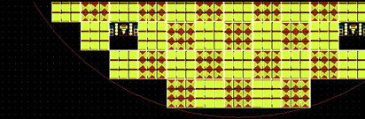

Devices from wafer Six_17 sent to Dr Christos Papavassiliou
at ICL on 15/01/2015
Stand-alone
Chip
Cross-bar
Alignment marks

Slide 2
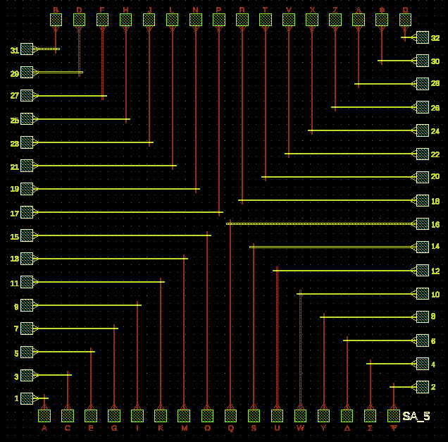
5x5 µm² stand-alone example
Single:
Pads = 75µm x 75µm. Period = 150 µm
Yellow lines = Bottom electrodes
Red lines = Top electrodes
SA_5 means 5x5 µm stand-alone

Slide 3
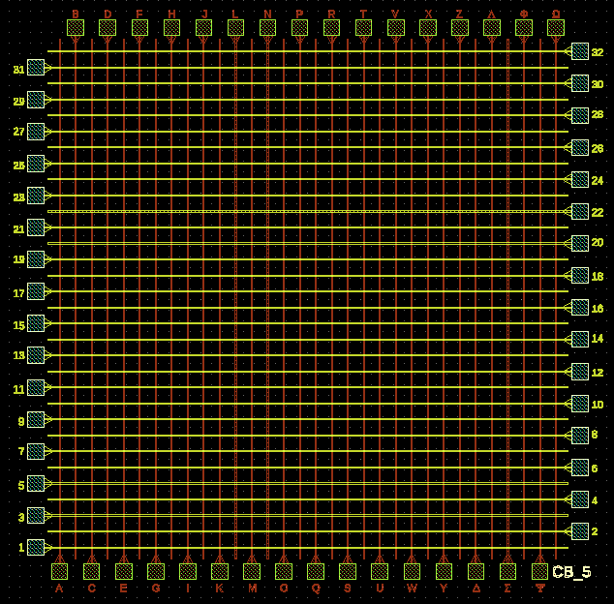
5x5 µm² crossbar array example
Array:
Pads = 75µm x 75µm. Period = 150 µm
Yellow lines = Bottom electrodes
Red lines = Top electrodes
CB_5 means 5x5 µm crossbar array

